Slide 1
REAL-TIME LICENSE PLATE RECOGNITION USING KNN ALGORITHM
MACHINE LEARNING IN PYTHON

Slide 2
Table of contents
01
02
03
04
05
Introduction
Problem & solution
Methodology
Coding & Execution
Conclusion

Slide 3
01
Introduction

Slide 4
Introduction
The idea
The concept
Real-time license plate detection is a computer vision application that uses artificial intelligence (AI) and image processing to automatically detect and recognize vehicle license plates from images or video streams in real time. The core idea behind this technology is to enable quick and accurate identification of vehicles for various applications like traffic management, law enforcement, toll collection, and parking systems.
License Plate Recognition (LPR) is a computer vision technology that automatically identifies vehicle license plates using cameras and optical character recognition (OCR). It captures images, processes them to extract plate numbers, and matches them against databases for applications like traffic enforcement, toll collection, and parking management. LPR enhances security, automates processes, and improves efficiency in transportation and law enforcement.

Slide 5
Main concepts behind LPR
Computer Vision
Machine Learning
Image Processing
License plate detection using computer vision involves capturing vehicle images, preprocessing them (grayscale conversion, noise reduction), and detecting the plate using edge detection or deep learning models like YOLO and Faster R-CNN. After localization, character segmentation separates individual letters/numbers, and OCR (e.g., Tesseract, CRNN) converts them into text.
License plate detection using machine learning involves preprocessing images (grayscale conversion, noise reduction) and detecting plates using traditional methods (Haar cascades, SVM) or deep learning models (YOLO, Faster R-CNN).Challenges like varying lighting, motion blur, and diverse plate formats are addressed through AI advancements, improving accuracy and real-time performance.
License plate detection using image processing involves capturing vehicle images and enhancing them through grayscale conversion, noise reduction, and edge detection (e.g., Canny Edge Detection). Contour detection and morphological operations help in locating the plate, while character segmentation isolates individual letters/numbers. Optical Character Recognition (OCR) converts these characters into text

Slide 6
02
Problem & solution

Slide 7
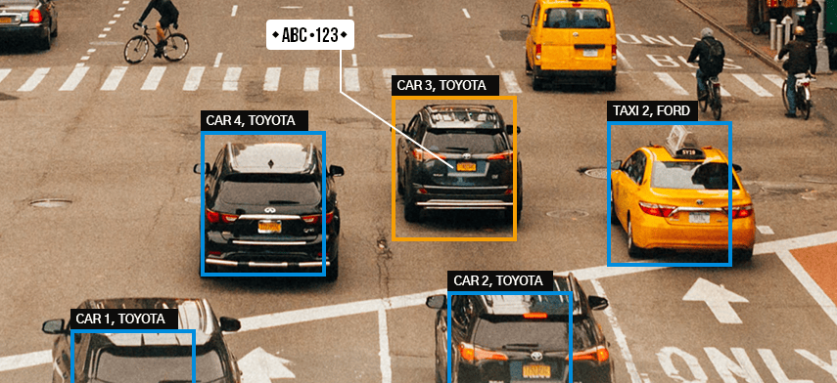
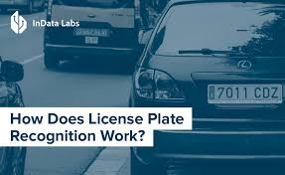
Problem Statement
How can a real-time license plate detection system be developed using computer vision and machine learning to accurately detect, localize, and recognize license plates under varied environmental conditions, different plate formats, and motion blur, ensuring efficient integration into traffic monitoring, toll collection, and security applications?

Slide 8
Solution
1. Image Acquisition
Image acquisition is the first step in license plate detection, using high-resolution and IR cameras for clear captures in all lighting conditions. Optimal placement and high-frame-rate cameras reduce distortion and motion blur.
2. Image Pre-processing
Image pre-processing enhances image quality for accurate license plate detection. It includes grayscale conversion to reduce complexity, noise reduction (Gaussian Blur) for clarity, and edge detection (Canny Edge Detection) to highlight plate boundaries. lighting.
3. License Plate Detection
License plate detection involves identifying and localizing the license plate from an image or video frame. Edge detection (Canny), contour detection, and morphological operations help detect rectangular plate regions in traditional methods, while deep learning models like YOLO, Faster R-CNN, and SSD offer higher accuracy.

Slide 9
4. Character Segmentation
Character segmentation separates individual letters and numbers from the detected license plate using binarization, contour detection, and morphological operations. Connected component analysis (CCA) isolates characters for accurate OCR processing, ensuring reliable recognition in traffic enforcement and toll systems.
5. Optical Character Recognition (OCR)
Optical Character Recognition (OCR) converts segmented license plate characters into machine-readable text. It uses Tesseract OCR, CNN-based models, or LSTMs for accurate recognition. Pre-processing like binarization and noise removal improves accuracy, while error correction algorithms handle misreads.
6. Post-Processing & Validation
Post-processing & validation refine OCR results to ensure accuracy in license plate recognition. Error correction techniques, such as dictionary matching and pattern validation, fix misread characters. Checksum algorithms and database cross-referencing help verify plate authenticity. This step improves reliability for applications like law enforcement, toll collection, and parking management, reducing false detections

Slide 10
SWOT Analysis
Strengths
Weaknesses
Automates vehicle identification, reducing manual effort.
Fast and accurate plate recognition with KNN.
Enhances security in parking, tolls, and law enforcement.
S
W
Accuracy drops in poor-quality images.
Struggles with obstructed or damaged plates.
Sensitive to environmental factors (rain, glare).
Opportunities
Threats
O
T
Integration with AI for better recognition.
Expansion into smart cities and traffic management.
Enhancements with deep learning models (CNNs).
Privacy concerns over vehicle tracking.
Legal restrictions on data storage and use.
Vulnerability to spoofing or tampered plates.

Slide 11
03
Methodology

Slide 12
Techniques Used
1. Image Preprocessing (preprocess.py)
Grayscale Conversion:
Extracts the value (brightness) channel from the HSV color space.
This simplifies image processing by reducing color information.
Contrast Enhancement (maximize Contrast):
Uses morphological operations (top-hat and black-hat) to improve contrast.
cv2.morphologyEx(img, cv2.MORPH_TOPHAT, structuringElement): Highlights bright regions on a dark background.
cv2.morphologyEx(img, cv2.MORPH_BLACKHAT, structuringElement): Highlights dark regions on a bright background.
Gaussian Blur:
Reduces noise and smooths the image.
cv2.GaussianBlur(img, GAUSSIAN_SMOOTH_FILTER_SIZE, 0)
Adaptive Thresholding:
Converts the grayscale image to a binary image (black and white).

Slide 13
cv2.adaptiveThreshold(img, 255.0, cv2.ADAPTIVE_THRESH_GAUSSIAN_C, cv2.THRESH_BINARY_INV, ADAPTIVE_THRESH_BLOCK_SIZE, ADAPTIVE_THRESH_WEIGHT)
Adaptive thresholding is used because lighting conditions can vary across the image.
2. Plate Detection (detectplates.py)
Contour Detection:
Finds the outlines of shapes in the thresholded image.cv2.
findContours(img, cv2.RETR_LIST, cv2.CHAIN_APPROX_SIMPLE)
Character Filtering (check If Possible Char):
Filters contours based on size, aspect ratio, and area to identify potential characters.
Matching Character Grouping (find List Of Lists Of Matching Chars):
Groups characters that are close together and have similar properties.
Uses distance, angle, area, width, and height comparisons.
Plate Extraction (extract Plate):
Calculates the bounding rectangle for the grouped characters.
Applies rotation and cropping to isolate the plate region.
cv2.getRotationMatrix2D() and cv2.warpAffine() are used to rotate the image.
cv2.getRectSubPix() is used to crop the rotated image.

Slide 14
3. Character Segmentation (detectchars.py)
Contour Detection:
Finds contours within the plate image.
Filtering (check If Possible Char):
Filters contours to identify potential characters.
Character Grouping (find List Of Lists Of Matching Chars):
Groups characters based on geometric properties.
Overlapping Character Removal (remove Inner Overlapping Charts):
Removes inner overlapping characters, to clean up the character list.
4. Character Recognition (detectchars.py)
K-Nearest Neighbors (KNN):
Classifies characters based on a trained dataset.cv2.ml.
KNearest_create() and kNearest.train(): Creates and trains the KNN model.
kNearest.findNearest(): Predicts the character.
Feature Extraction
Resizes character images to a fixed size for consistent input to KNN.
cv2.resize()

Slide 15
5. Display and Output (main.py)
Drawing Rectangles:
Draws a red rectangle around the detected plate.
cv2.line() and cv2.boxPoints()
Text Output:
Writes the recognized characters onto the image.
cv2.putText()
KNN Model
K-Nearest Neighbors (KNN) is a straightforward machine learning algorithm used for both classification and regression. Instead of creating a complex model during training, it simply stores the entire training dataset. When you want to predict the class or value of a new data point, KNN does the following:
Calculates Distances: It computes the distance between the new data point and every point in the training set (using metrics like Euclidean distance).
Finds Nearest Neighbors: It identifies the "k" data points in the training set that are closest to the new point, where "k" is a user-defined number.
Makes Predictions:
For classification, it assigns the new point to the class that appears most frequently among those "k" neighbors (majority vote).
For regression, it predicts the value of the new point by averaging the values of its "k" nearest neighbors.

Slide 16
Modules and Data Structures
Important Modules
cv2 (OpenCV): Image processing and computer vision library. Used for image loading, manipulation, contour detection, morphology, thresholding, and drawing.
numpy: Numerical computing library. Used for array operations and image data representation.
os: Used for operating system dependent functionality, such as file path manipulation.
math: Used for mathematical operations, like square root, and trigonometric functions.
Key Data Structures
Possible Char: Represents a potential character with its contour, bounding rectangle, and geometric properties.
Possible Plate: Represents a potential license plate with its image, location, and recognized characters.
NOTE: The system relies on a pre-trained KNN model (classifications.txt and flattened-images.txt).

Slide 17
04
Coding & Execution

Slide 18
Control Flow for LPR
For finding Plates
imgOriginalScene
preprocess()
imgGrayscaleScene, imgThreshScene
findPossibleCharsInScene()
listOfPossibleCharsInScene
findListOfListsOfMatchingChars()
listOfListsOfMatchingCharsInScene
extractPlate()
listOfPossiblePlates
detectPlatesInScene()

Slide 19
Find Chars Within Plates
listOfPossiblePlates
preprocess()
imgGrayscale, imgThresh
findPossibleCharsInPlate()
listOfPossibleCharsInPlate
findListOfListsOfMatchingChars()
listOfListsOfMatchingCharsInPlate
removeInnerOverlappingChars()
listOfListsOfMatchingCharsInPlate
detectCharsInPlate()
within each possible plate, suppose the longest list of potential matching chars is the actual list of chars

Slide 20
longestListOfMatchingCharsInPlate
*loadKNNDataAndTrainKNN()
recognizeCharsInPlate()
possiblePlate.strChars
listOfPossiblePlates
licPlate
Suppose the plate with the most recognized characters is the actual plate
*loadKNNDataAndTrainKNN() is actually called at the beginning of the program, it does not matter when this is called, so long as it's called before recognizeCharsInPlate()

Slide 21
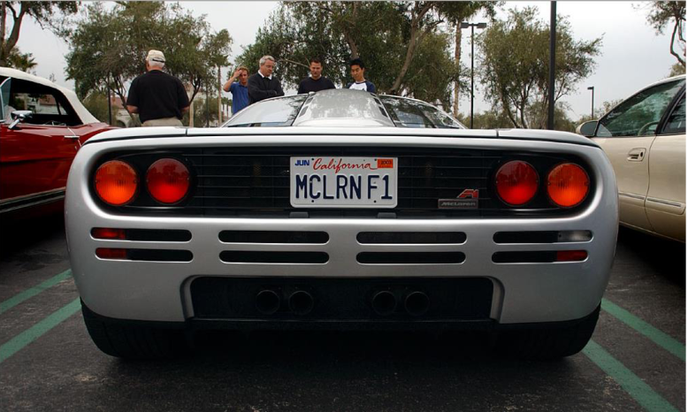
Execution Steps
imgOriginalscene
preprocess()

Slide 22
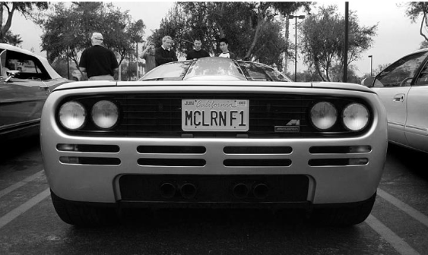
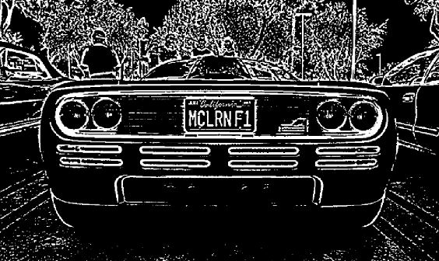
ImgGreyscalescene
imgthreshscene

Slide 23
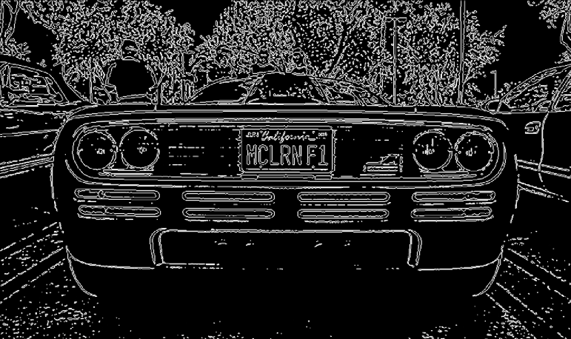
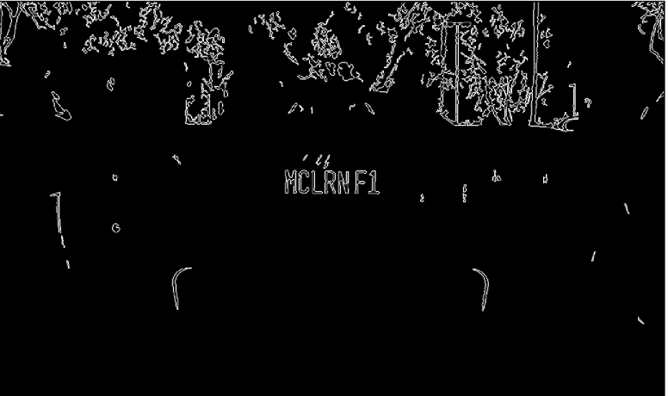
findpossiblecharsinscene()
All contours
vectorofpossiblecharinscene
(131 w/ MCLRN F1 image)
findvectorofvectorsofmatchingchar()

Slide 24
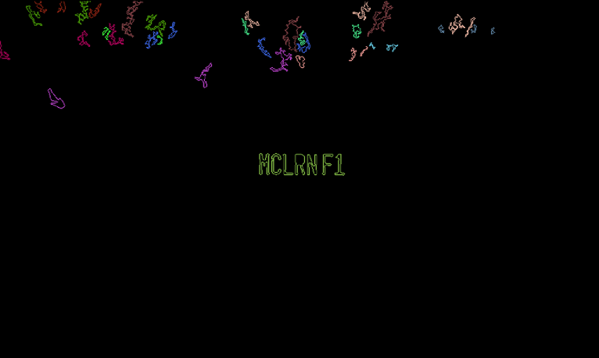
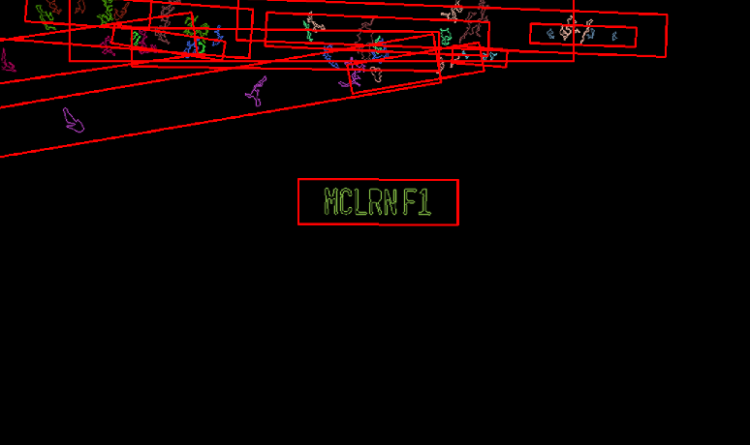

vectorofvectorsofmatchingcharinscene
(131 w/ MCLRN F1 image)
Extract plate()
vectorofpossibleplate
(131 w/ MCLRN F1 image)
preprocss()

Slide 25




imgGreyscale
imgThresh
FindPossibleCharInPlate()
vectorOfPossibleCharsInPlate
findVectorOfVectorsOfMatchingChars()
vectorOfVectorsOfMatchingChars()

Slide 26



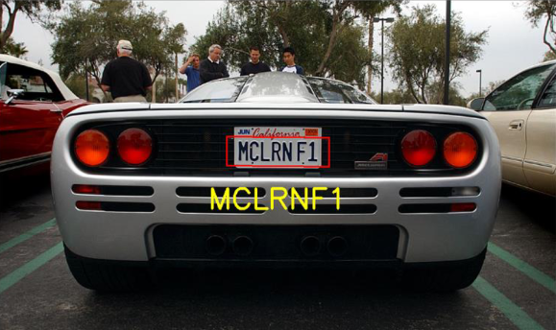
removeInnerOverlappingChars()
vectorOfVectorsOfMatchingCharsInPlate
within each possible plate, suppose the longest list of potential matching chars is the actual list of chars
longestVectorsOfMatchingCharsInPlate
recognizecharinplate()
possibleplate.srtchar
Suppose the plate with most recognized chars is the actual plate

Slide 27
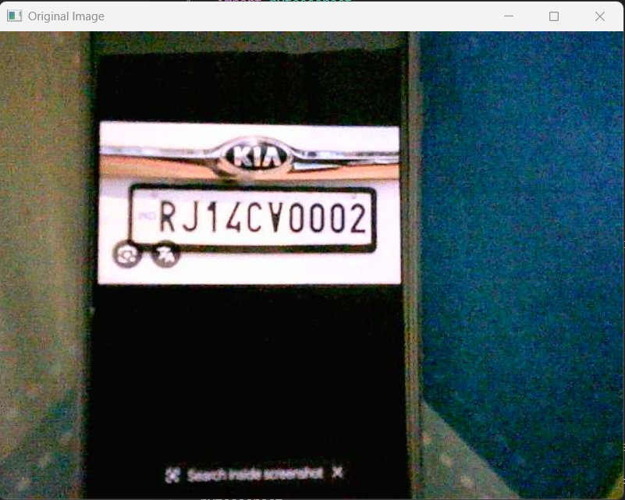
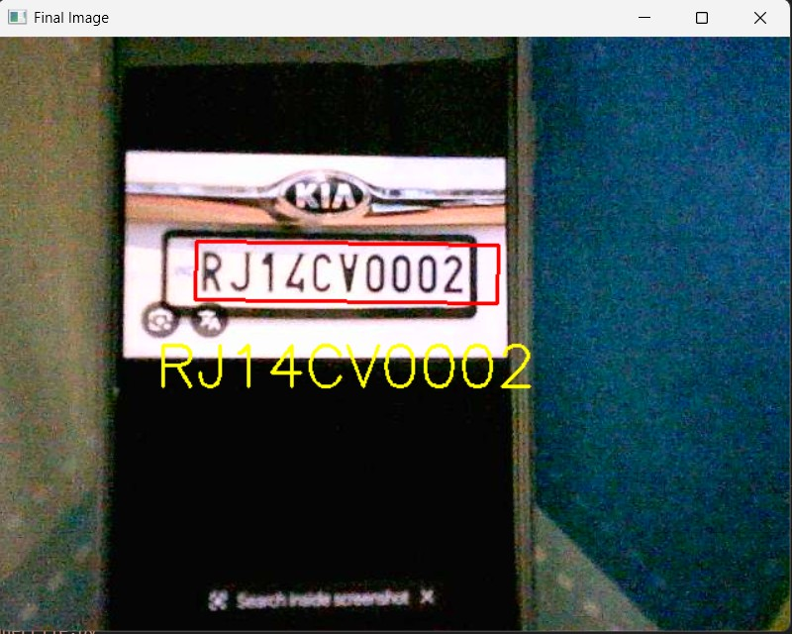
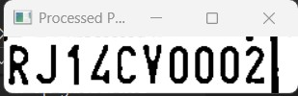
Real-Time Implementation

Slide 28
05
Conclusion

Slide 29
Conclusion
License plate detection and recognition involve a structured pipeline combining image preprocessing, character segmentation, feature extraction, and OCR. The process starts with finding possible plates, followed by detecting characters within the plates, filtering out noise, and recognizing the most probable license plate using KNN-based classification. Post-processing techniques further refine the results for higher accuracy in real-world applications such as traffic enforcement, toll collection, and security systems. By leveraging computer vision and machine learning, this system ensures efficient and automated vehicle identification

Slide 30
Thanks!
Presented by:
Srinjayee Paul (2229075)
Shruthi Bangaru (2229067)
Nikhil Dwivedi (2229208)
Prateek Shishir (2229050)

